Slide 1
Hydrocarbon MetaPathways Tutorial:
Taxonomic Analysis
Niels W. Hanson
Ph.D. Candidate
Tuesday, February 11 2014
Bioinformatics Training Program
The University of British Columbia, Vancouver

Slide 2
Goals of Tutorial
Understand the basic background of the taxonomic signal related to the 16S rRNA, Clusters of Orthologous Genes (COGs), and MEGAN taxonomy.
Be able to prime taxonomic search results from MetaPathways for analysis in MEGAN via python scripts
Understand the declination of taxonomy in MEGAN and its ability to export samples
Outline some examples of downstream hierarchical clustering in the R statistical environment

Slide 3
Prerequisites
Install MEGAN - http://ab.inf.uni-tuebingen.de/software/megan5/
Install R Studio - http://www.rstudio.com/
Downloads
Presentation Slides - MetaPathways_Tutorial_Taxonomic_Analysis.pdf
Complete R Script - mp_tutorial_taxonomic_analysis.R
Megan-Compatible Files -
Megan-Table File - HOT_megan_table.txt

Slide 4
1. Overview of Taxonomic Annotation
Ribosomal rRNA Genes
Clusters of Orthologous Genes (COGs)
RefSeq Functional Taxonomy (LCA or MEGAN-taxonomy)

Slide 5
1. Overview of Taxonomic Annotation
Ribosomal rRNA Genes
Clusters of Orthologous Genes (COGs)
RefSeq Functional Taxonomy (LCA or MEGAN-taxonomy)

Slide 6
1. Overview of Taxonomic Annotation
Ribosomal rRNA Genes
Clusters of Orthologous Genes (COGs)
RefSeq Functional Taxonomy (LCA or MEGAN-taxonomy)

Slide 7
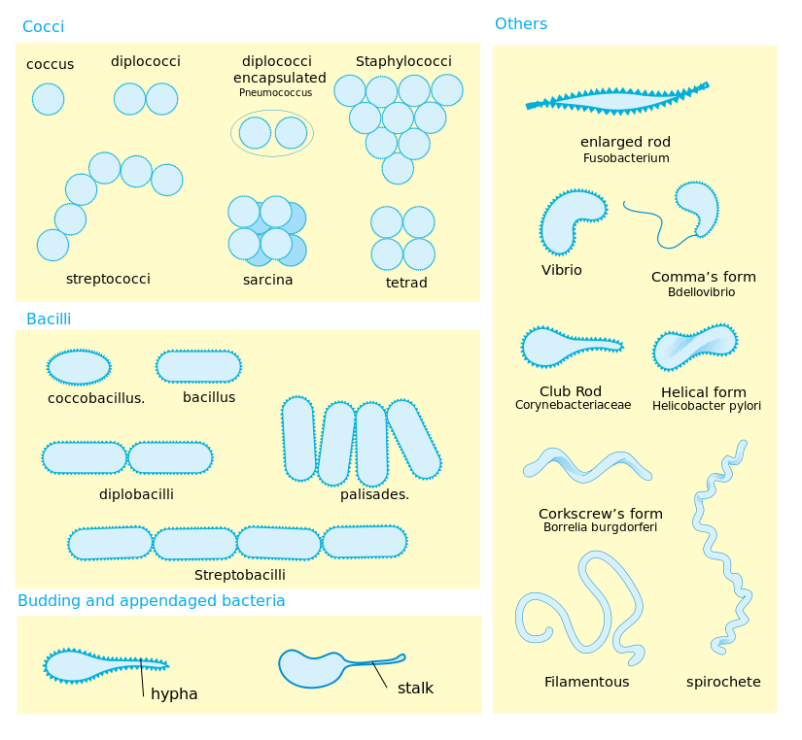
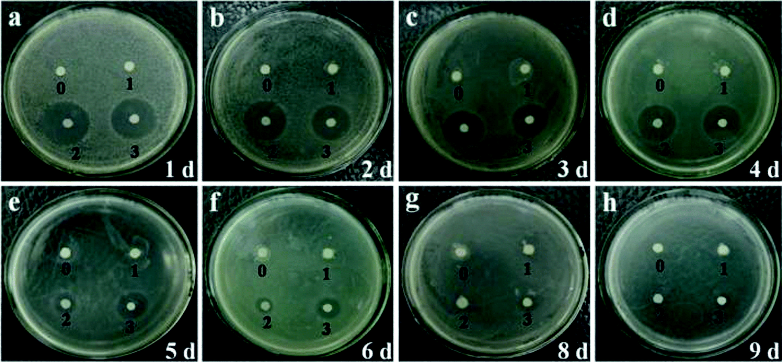
Ribosomal rRNA Genes (e.g., 16S, 18S)
Differences in morphology & growth of microbes insufficient to determine phylogeny — thought high order organisms has most diversity (Five Kingdoms Model)
Enter DNA sequencing: certain genes taxonomically relevant rRNA genes (widely found, stable sequence)
Alignment of hyper variable regions of 16S lead to development of modern ‘tree-of-life

Slide 8
Ribosomal rRNA Genes (e.g., 16S, 18S)
Ribosomal rRNA
Alignment
“Tree-of-Life”

Slide 9
Ribosomal rRNA Genes (e.g., 16S, 18S)
small (16S and 18S) and large (23S and 28S) rRNA subunits catalogued in databases (Silva1, GreenGenes2)
16S quite specific, but… i. 16S Amplified by PCR (a.k.a., pyrotags) - PCR Biases within & differences in ‘universal’ primers makes relative abundance of taxa “semi-quantitative” at best3 ii. Metagenomes - Not sequencing specifically - taxonomic breadth limited
- Possibly more quantitative – no ‘universal’ primer bias
E. Pruesse et al., SILVA: a comprehensive online resource for quality checked and aligned ribosomal RNA sequence data compatible with ARB, Nucleic Acids Research 35, 7188–7196 (2007).
T. Z. DeSantis et al., Greengenes, a chimera-checked 16S rRNA gene database and workbench compatible with ARB, Appl. Environ. Microbiol. 72, 5069–5072 (2006).
J. G. Caporaso et al., QIIME allows analysis of high-throughput community sequencing data, Nat Meth 7, 335–336 (2010).

Slide 10
Clusters of Orthologous Genes
What’s so special about the 16S rRNA. COG a collection of single copy genes for taxonomic signal1
Triangle Homology Rule
“Any group of at least three proteins from distant genomes that are more similar to each other than they are to any other proteins are likely to form an orthologous set.”
R. L. Tatusov et al., The COG database: new developments in phylogenetic classification of proteins from complete genomes, Nucleic Acids Research 29, 22–28 (2001).

Slide 11

RefSeq Functional Taxonomy Metagenome Analyzer (MEGAN)
Genes identified in RefSeq have underlying genome of origin. - High quality hits possibly contain a (noisy) taxonomic signal
Megan an interactive software to implement the Lowest Common Ancestor (LCA) algorithm

Slide 12
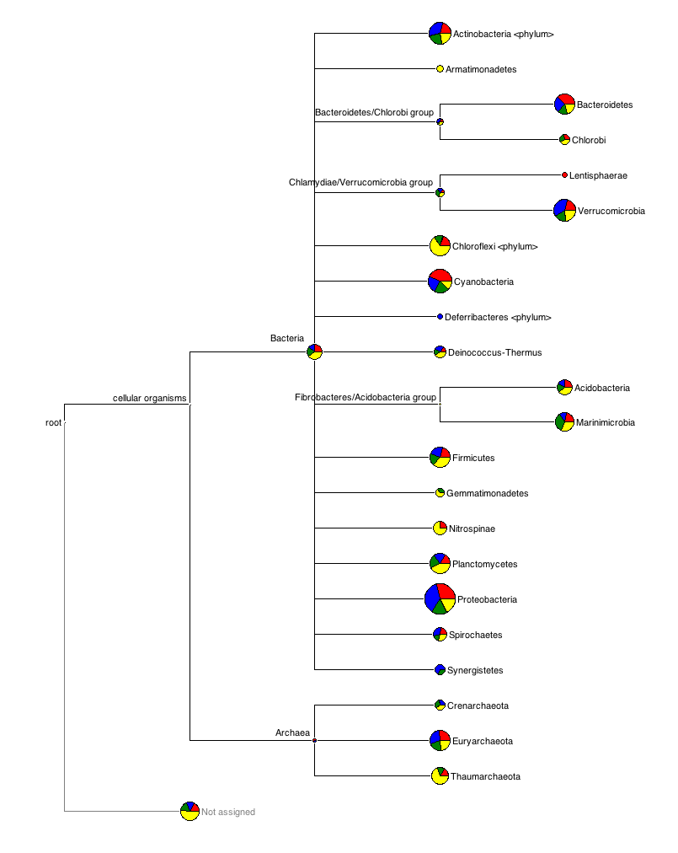
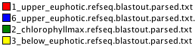
RefSeq Functional Taxonomy Metagenome Analyzer (MEGAN)

Slide 13
2. Priming MetaPathways output for MEGAN
Take rRNA (Silva, GreenGenes), RefSeq, and COG hits to MEGAN
Python Scripts
rRNA - metapathways_rRNA_to_megan.py
RefSeq - metapathways_last_to_megan.py
COG - metapathways_COG_to_megan.py

Slide 14
Priming MetaPathways output for MEGAN
Python Scripts
metapathways_rRNA_to_megan.py
$ python metapathways_rRNA_to_megan.py -i *.rRNA.stats.txt
-o output_folder .
[--dsv]
metapathways_last_to_megan.py
metapathways_COG_to_megan.py

